Slide 1
Segmentation
CSCI 4150/6050: Computer Vision

Slide 2
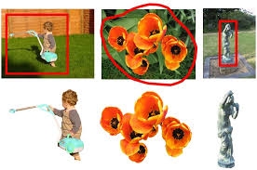
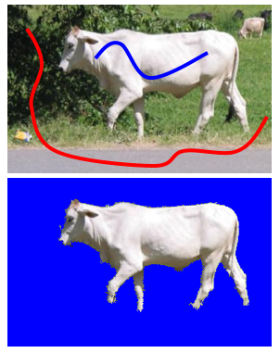
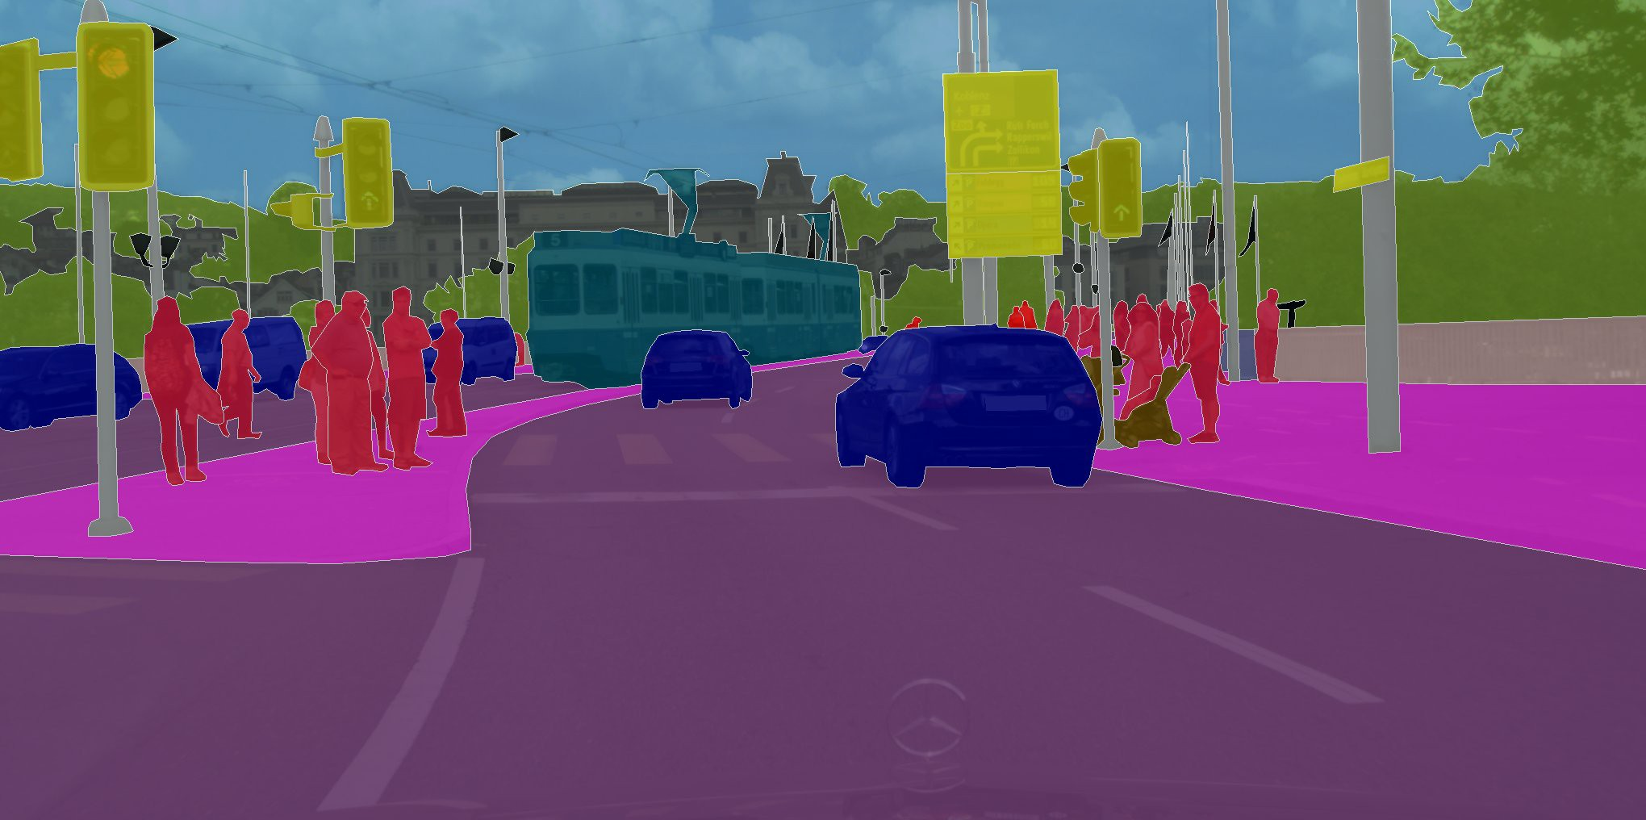
Segmentation
Segmentation is the partitioning of an image or video into different regions
These regions ideally correspond to objects
Variations:
  Supervised vs. unsupervised
  Binary: foreground vs. background
  Multiple objects / complete partitioning
  Semantic

Slide 3
Let’s start with a simple example in Photoshop…

Slide 4
There are a lot of segmentation techniques…
Neural Network Approaches
Classical Methods
 | User Interaction (Supervised) | No User Interaction (Unsupervised)
Edge Based | Deformable Models Active Contours Intelligent Scissors | Edge Linking Hough Transform
Region Based | Connected Components Region Growing Graph Cut | Watersheds Mean-shift Clustering Superpixels
Semantic Segmentation
Fully Convolutional Networks
U-Net
Instance Segmentation
Mask R-CNN
Detectron 2
State of the Art
Vision Transformers
Segment Anything
And much much more…

Slide 5
There are a lot of segmentation techniques…
Neural Network Approaches
Classical Methods
 | User Interaction (Supervised) | No User Interaction (Unsupervised)
Edge Based | Deformable Models Active Contours Intelligent Scissors | Edge Linking Hough Transform
Region Based | Region Growing Distance-Based Graph Cut | Watersheds Mean-shift Clustering Superpixels
Semantic Segmentation
Fully Convolutional Networks
U-Net
Instance Segmentation
Mask R-CNN
Detectron 2
State of the Art
Vision Transformers
Segment Anything
And much much more…
We can’t cover all of these, but we will try to hit some key developments

Slide 6
Let’s start with the simplest segmentation techniques…

Slide 7
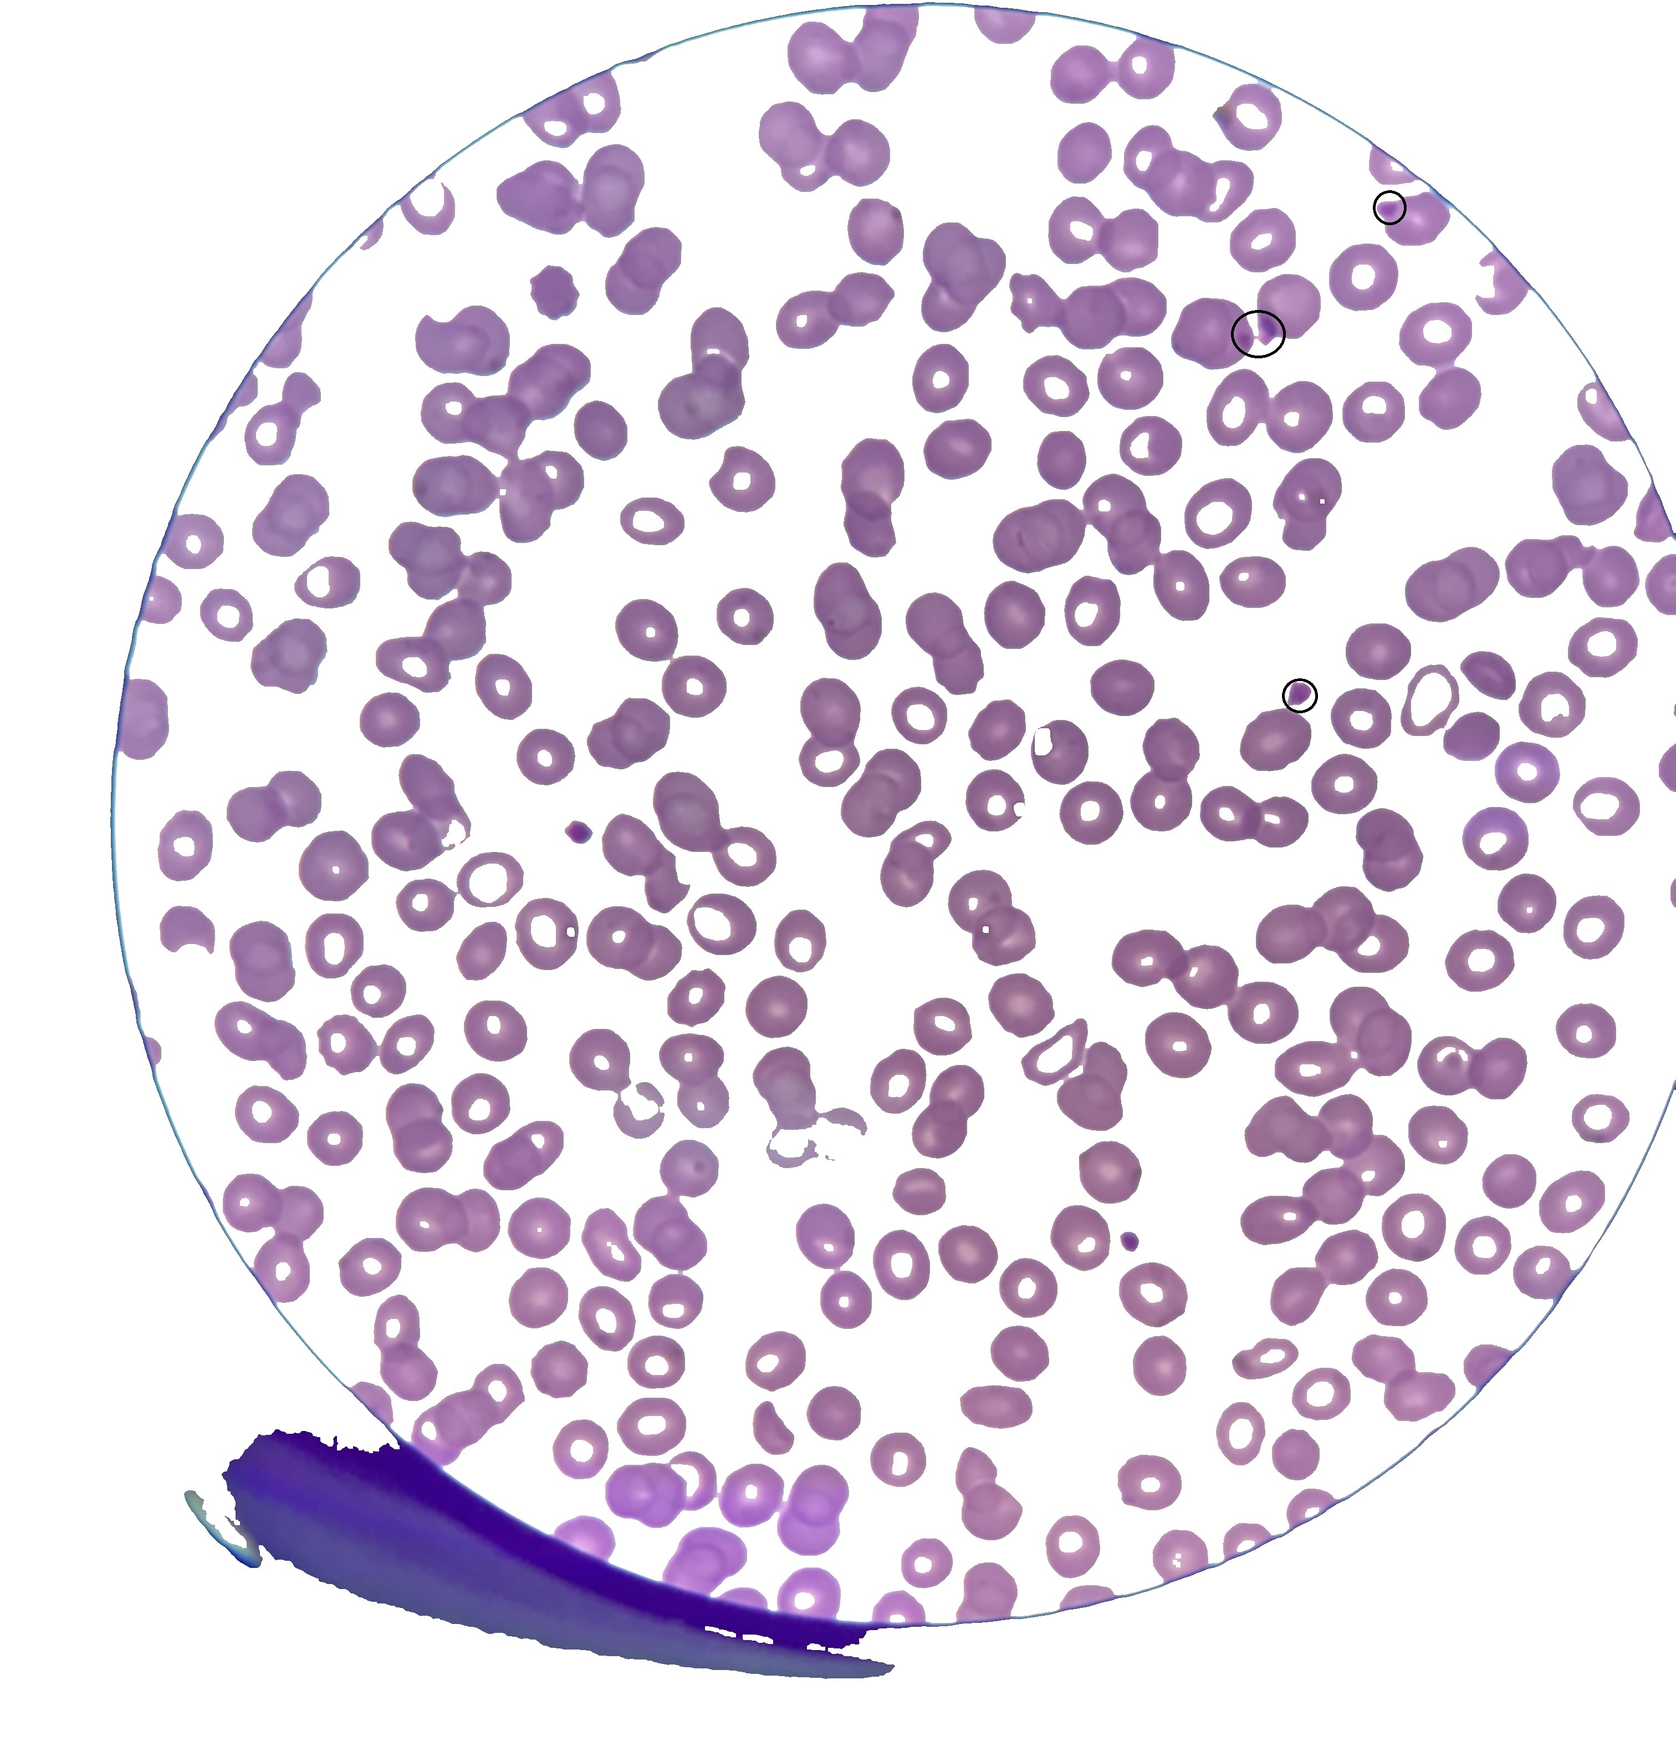
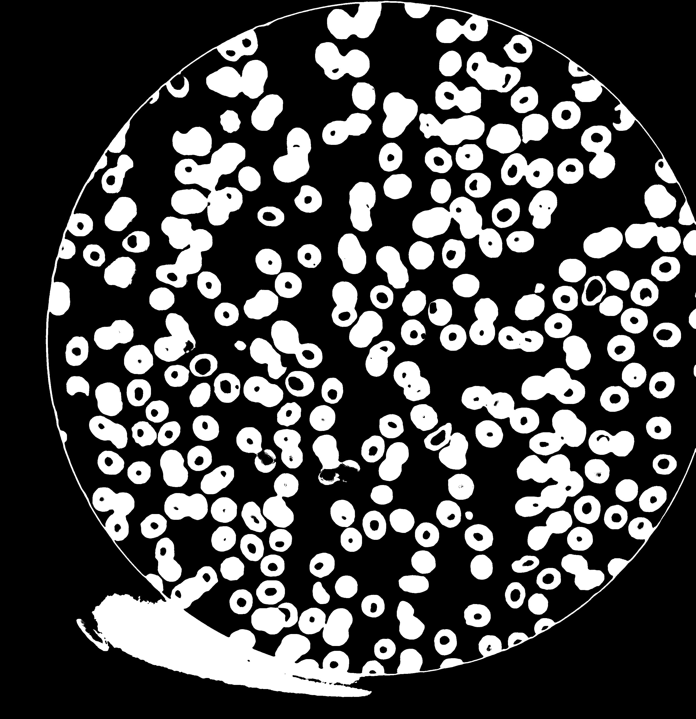
Review: Connected Components
Very simple segmentation technique, often used for medical data.
Key Idea: Threshold the entire image. Any set of connected pixels is the same object.
https://answers.opencv.org/question/230252/separating-conjoined-blobs/

Slide 8
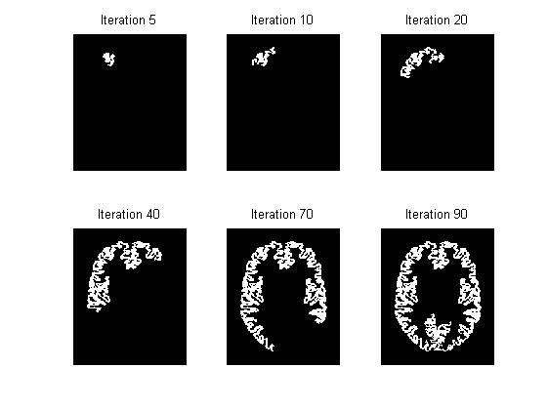
Review: Magic Wand
Same idea as connected components, but iteratively add adjacent pixels if they are “close enough” in color to the original seed color.
Formally known as Region Growing
Problems:
  Stopping prematurely
  Leaking through weak boundaries

Slide 9
Let’s look at the Magic Wand Tool in Photoshop…
Flood Select in Affinity Photo

Slide 10
Region-Based
Core idea: group pixels based on common properties (“affinity”)
  Color
  Texture
  Motion
  and lots of other properties …

Slide 11
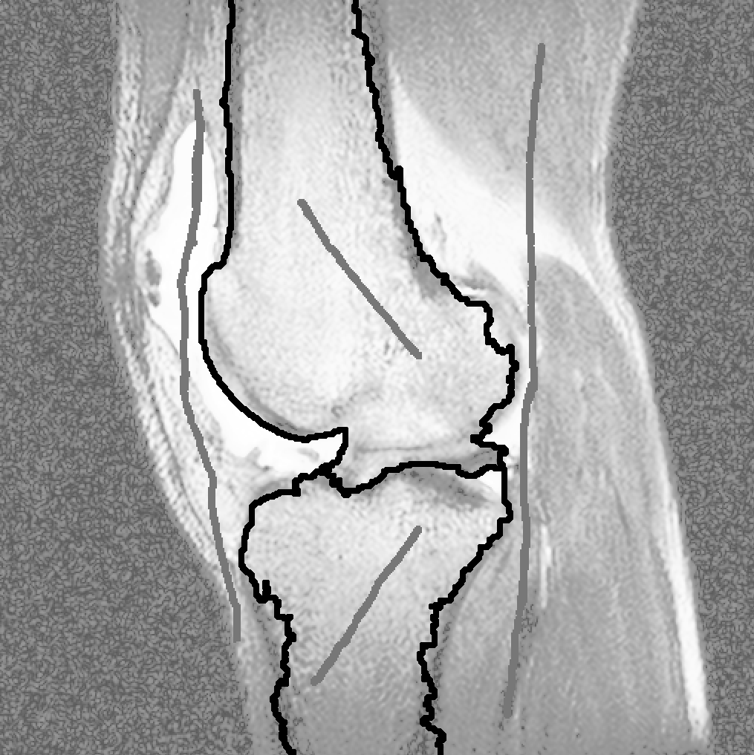
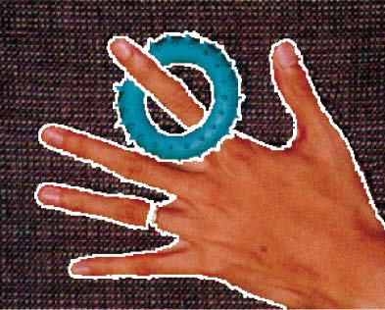
Region-Based
Supervised:
  Region Growing
  Distance-based approaches
  Random walks
  Graph cuts
Unsupervised:
  Gradient watersheds
  Graph spectral approaches
  Clustering
  (including mean-shift clustering)

Slide 12
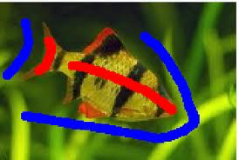
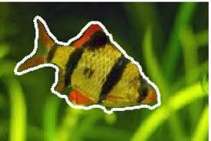
Supervised Segmentation
What is in red is what we want, what is in blue is the background. Slowly add seeds or information of what should be included and what should not.
Core idea: start with some set of pixels known to be in the object(s) / background
Two key things you can learn from them:
  Appearance
  Spatial proximity
Use these properties to segment the rest
Basis for most interactive segmentation tools:
  Place initial seed pixels
  Segment and display results
  Allow user to place other “corrective” seeds
  Resegment and update
  Repeat…

Slide 13
Graph-Cut Segmentation
Treat the segmentation as an optimization given the known seeds.
Bayesian-like cost function:
  Likelihood: labeled pixels should look like the seeds for their region
  Prior: similar neighbors should go in
  similar regions (smoothness)
Can frame minimization of objective function as the minimum-cost cut through a graph
(known low-degree polynomial-time solutions)

Slide 14

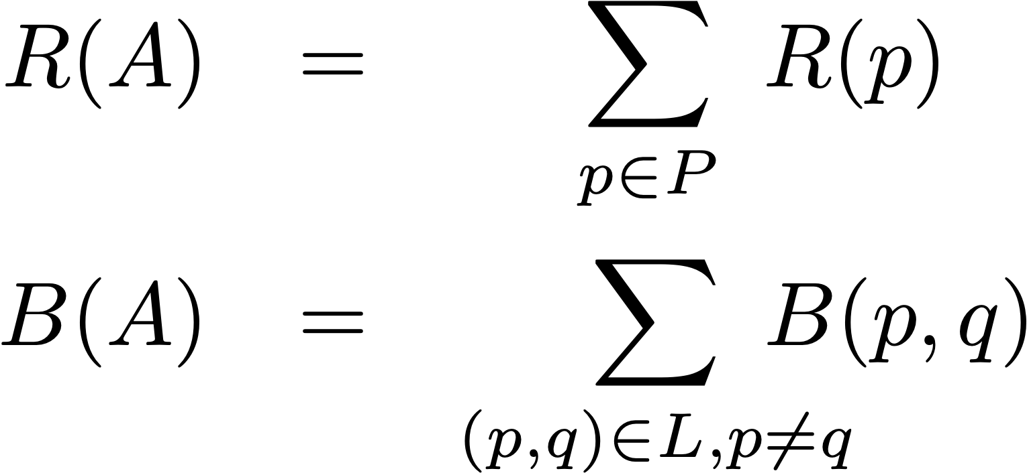
Graph-Cut Segmentation
Raph cut tries to seperate a graph into half with minimal cost. Ie seperate for and background.
Let
  P = set of all image pixels
  L = set of links between neighbors
  A = a vector of binary pixel labels
Minimize objective function E(A):
  Region term penalizes labeling pixels that don’t look like the seeds
  Boundary term penalizes labeling similar neighbors with different labels

Slide 15
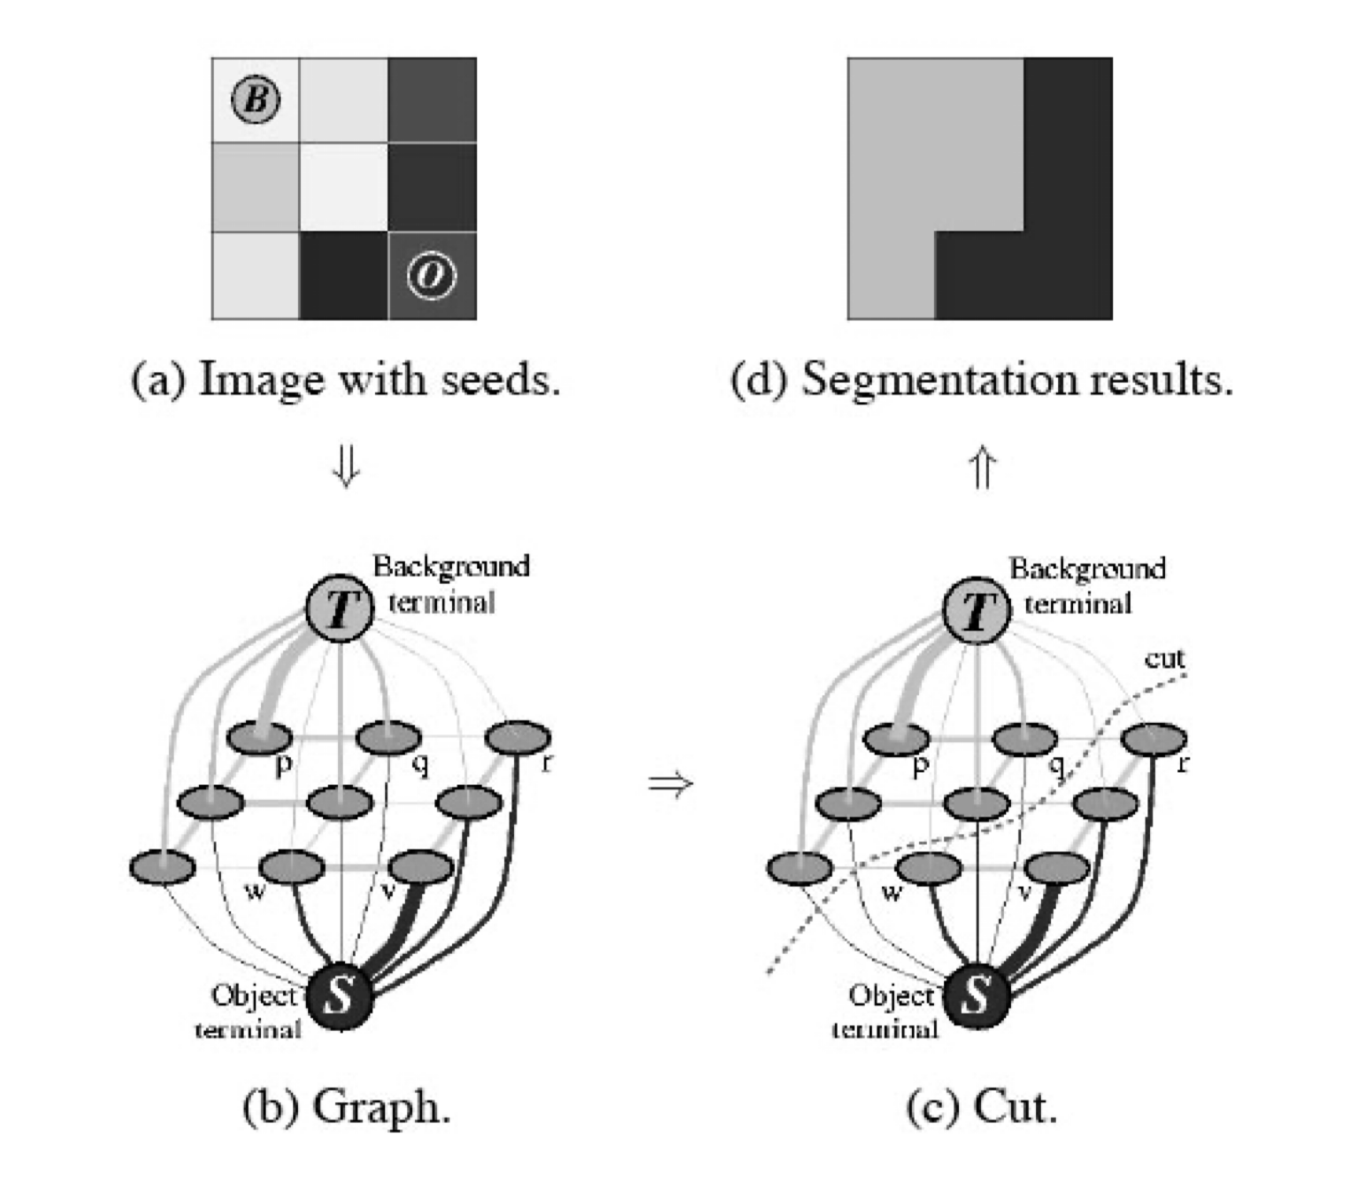
Optimization as Graph Cuts
Nodes (graph vertices):
  One node for each pixel
  Additional terminal node for each region
Links (graph edges or arcs):
  Between neighboring pixels (“n-links”)
  Between terminals and every pixel (“t-links”)
Cost to cut n-link is based on pixel similarity B(p,q)
(intuition: cutting n-link is assigning different labels)
Cost to cut t-link is based on swapped R(p)
(intuition: cutting a t-link is not applying that label)
Find the minimum-cost cut separating terminal nodes
(figure from Boykov & Jolly, ICCV 2001)

Slide 16
Let’s look at the Quick Select Tool in Photoshop…
Selection Brush in Affinity Photo

Slide 17
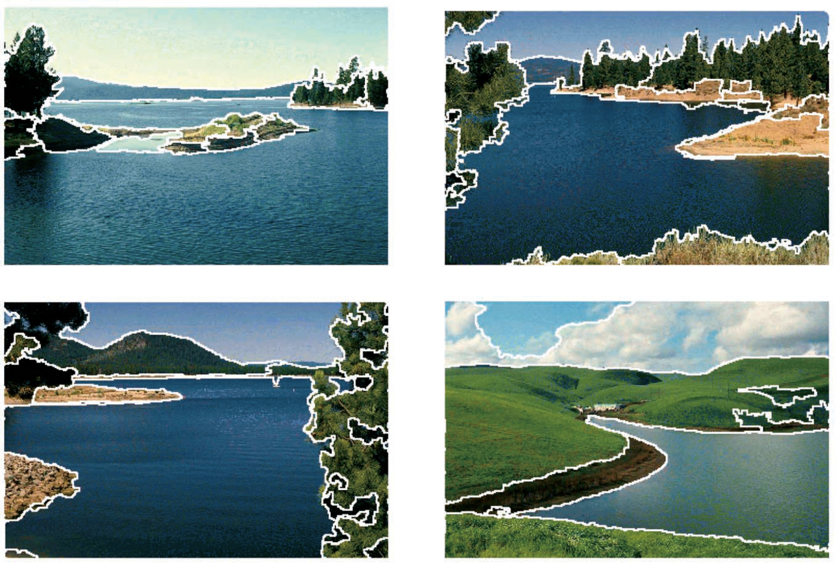
Unsupervised Segmentation
Unsupervised segmentation does not require user interaction or any prior indication of target regions
Partition the image into coherent regions
More recent variant:
  Find “salient” objects of interest
  Segment those
  Don’t worry about otherwise complete partitioning (“background”)

Slide 18
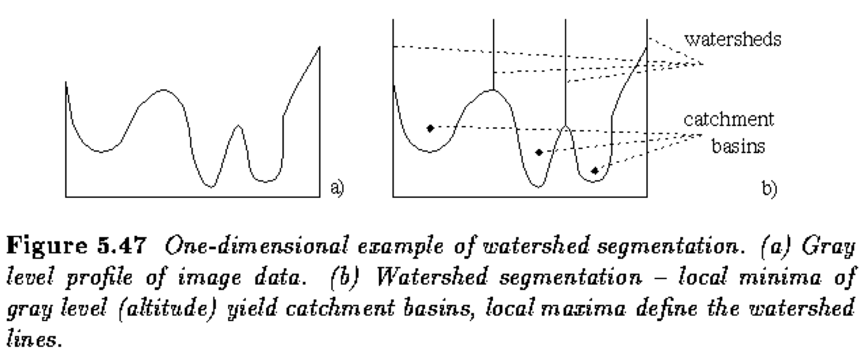
Gradient Watersheds
A “watershed” or “catchment basis” is a region over which all water flows downhill to a common destination
Example: continental divide of the U.S.
Core idea of watershed segmentation:
  Build a gradient-magnitude image
  Compute watershed regions
  (lots of efficient algorithms)
Can smooth the original/gradient image first to reduce noise / produce larger regions

Slide 19
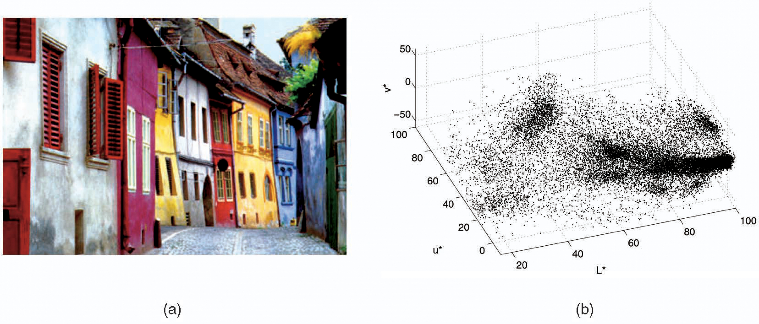
Unsupervised Segmentation as Clustering
Basic idea: unsupervised segmentation is really a form of clustering pixels
Consider the pixels as points in color space and cluster
Problem: clustering in color space alone doesn’t consider spatial aspects
Solution: cluster in 5-dimensional space:
  Color (3)
  Spatial position (2)

Slide 20
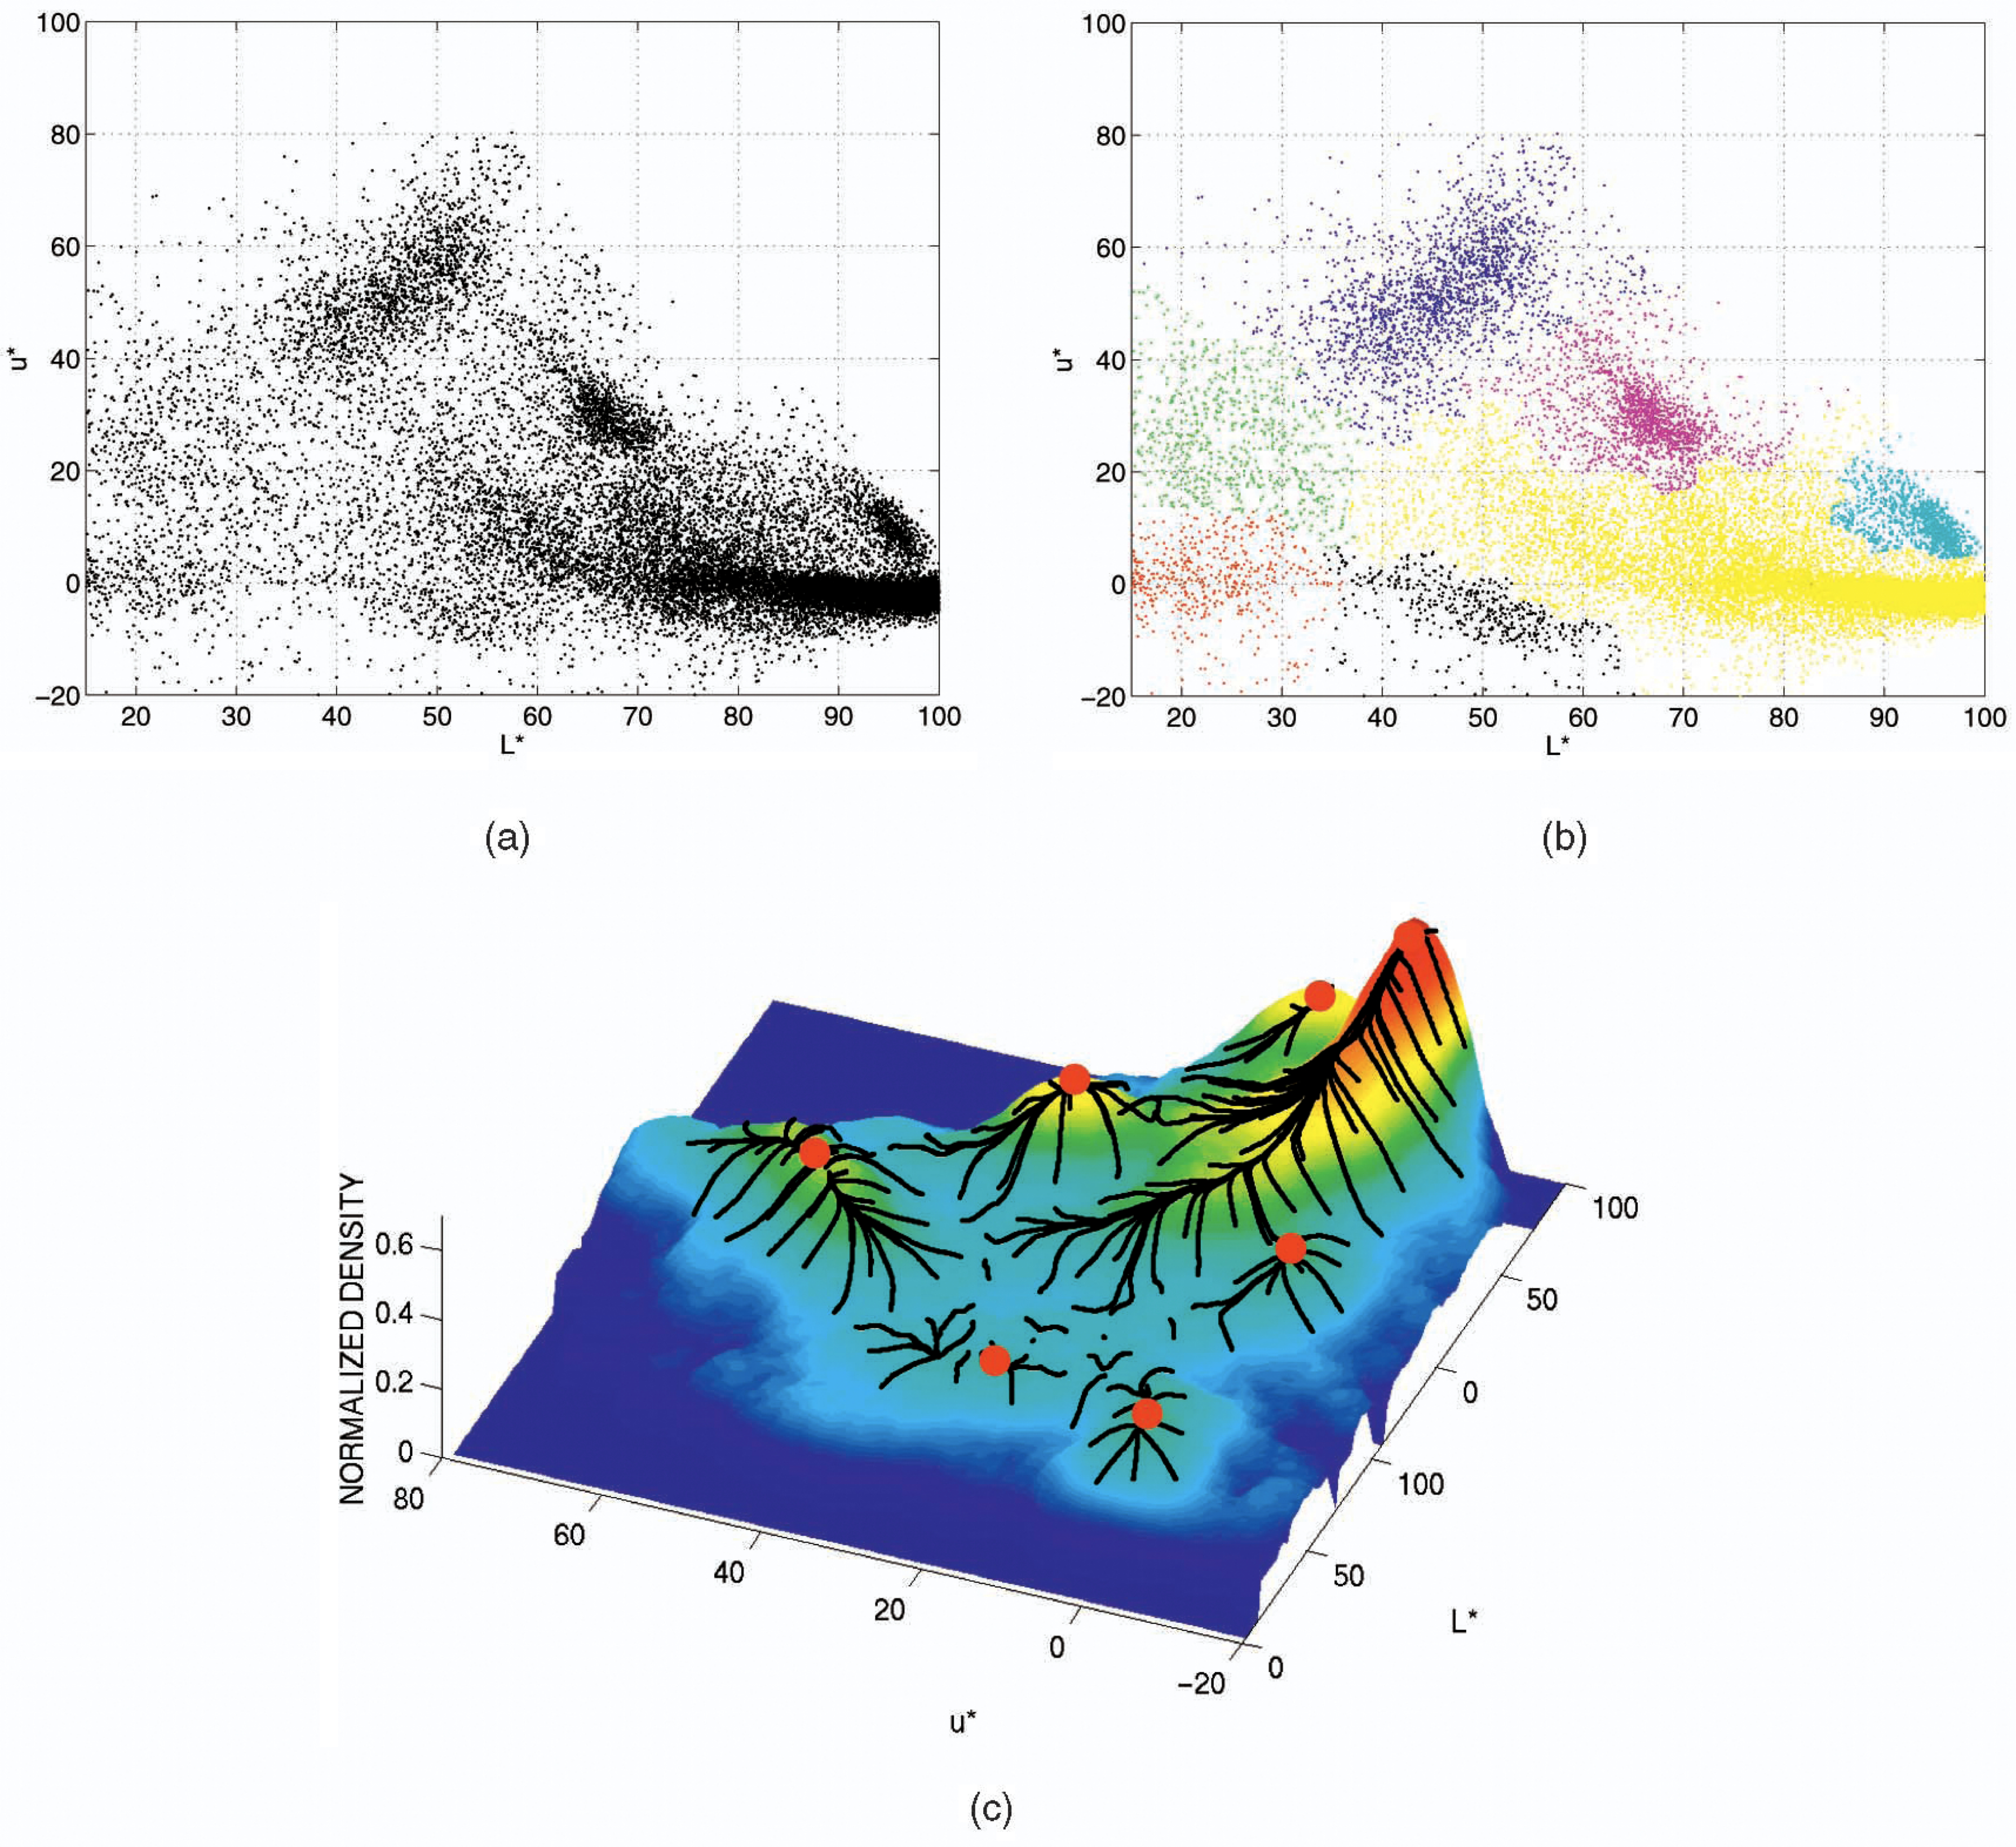
Mean-Shift Segmentation
Mean shift predicts how many areas or clusters there are so they can be seperated. This and all the above are classical methods.
Consider the different regions as having
(non-simple) color/space distributions
The image is in a sense a mixture model
How to cluster when the distributions aren’t simple ones?
Idea: smooth to approximate distributions
(i.e., kernel density estimation) and then
find modes in the distribution
All of the points that would “flow uphill” to a common mode are part of the same region
(like upside-down watersheds)

Slide 21
Mean-Shift Segmentation

Slide 22
Unsupervised Segmentation
All unsupervised methods have to balance extremes:
  Oversegmentation:
  lots of tiny regions
  Undersegmentation:
  regions not fine enough
Most have parameters to provide control:
  Image smoothing
  (watersheds)
  KDE smoothing
  (mean-shift)
  Subdivision / how many eigenvectors
  (spectral approaches)

Slide 23
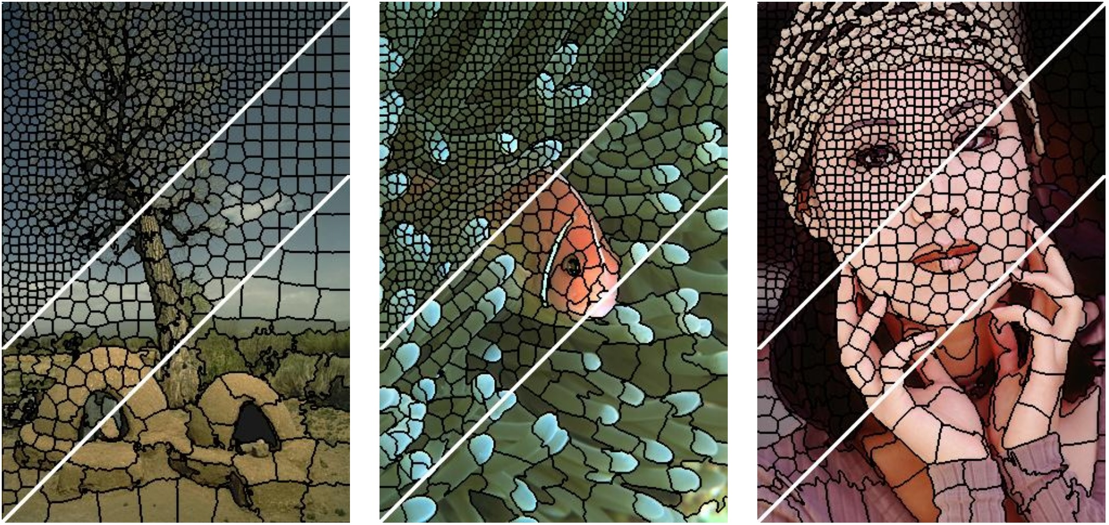
Superpixels
Its easier to get more information with superpixels and we can then use this with other operations. Still classical.
Idea: use unsupervised segmentation to severely over-segment the image
Each segmented region is nearly homogeneous
Treat these regions as “superpixels”
Employ other algorithms using these superpixels instead of basic pixels
  Example: much smaller graph to cut!
Can control size / number of superpixels
  More superpixels: more homogeneous regions
  Fewer superpixels: faster for other algorithms
Example of SLIC superpixels

Slide 24
Key Takeaways
Many segmentation algorithms are an optimization between a likelihood and a prior
  Edge-based: Starting contour and smooth path through gradient.
  Region-based: Proximity to seed pixel colors and boundary properties.
Many approaches match both color distributions and spatial locations of pixels.
Pixel data can be clustered like any other data.
Algorithms have to balance between under and over segmenting the region.

Slide 25
Check out the slides on Canvas additional details on region-based techniques, graph cut, and mean shift clustering.

Slide 26
There are a lot of segmentation techniques…
Neural Network Approaches
Classical Methods
 | User Interaction (Supervised) | No User Interaction (Unsupervised)
Edge Based | Deformable Models Active Contours Intelligent Scissors | Edge Linking Hough Transform
Region Based | Region Growing Distance-Based Graph Cut | Watersheds Mean-shift Clustering Superpixels
Semantic Segmentation
Fully Convolutional Networks
U-Net
Instance Segmentation
Mask R-CNN
Detectron 2
State of the Art
Vision Transformers
Segment Anything
And much much more…
We can’t cover all of these, but we will try to hit some key developments

Slide 27
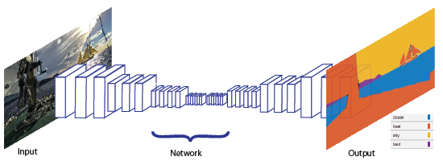
Semantic Segmentation
In network, reduce the size as we go in while increasing dimensions, then append the reversed version of that network to produce a simpler segmentation image. The regions are tested with labeled
Segments, we have the loss, back prop? And the process continues. These helps and could be used in robotics, self driving cars etc
Unsupervised segmentation struggles with lack of meaning for the regions
Semantic segmentation tries to address this by labeling pixels based on common semantic meaning, not just common local appearance
Assumes small set of labels: road, car, sign, pedestrian, sky, other background, etc.
Most common approach today is a deep neural encoder/decoder (or U-Net)
The number of classes is usually limited
(not as powerful as a full detector)

Slide 28
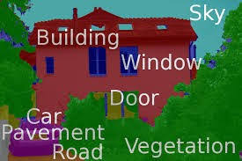
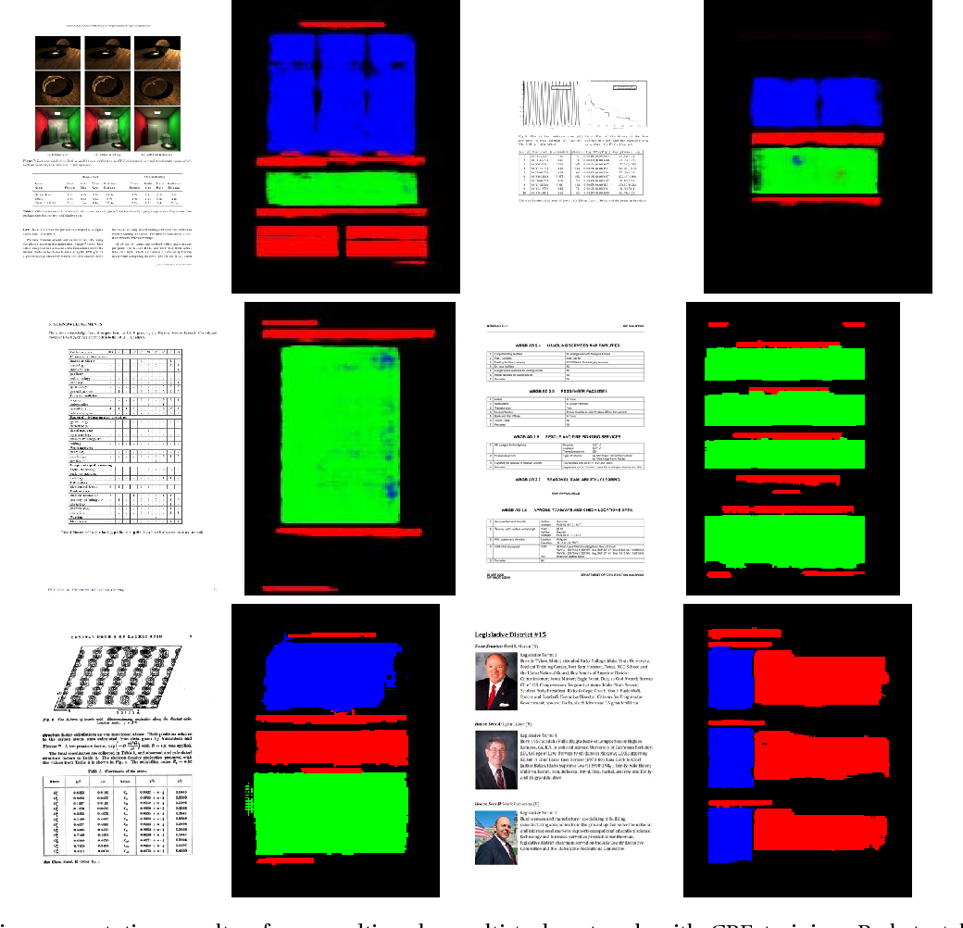
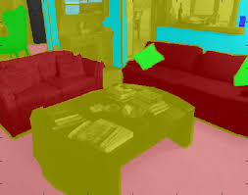
Semantic Segmentation

Slide 29
Whiteboard Discussion
Pixel-wise Classification

Slide 30
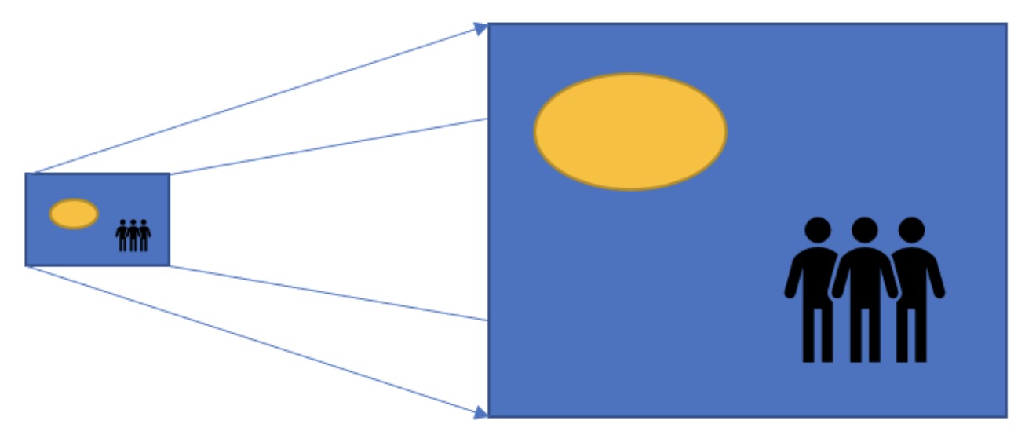
Upsampling images
We use pooling to shrink images, but how do we make them larger?
What could use the resizing techniques we learned before
  Nearest neighbor interpolation
  Bi-linear interpolation
  Bi-cubic interpolation
Is there a better way?
Doing this at every layer in the network using the cpu at each step really slows down the training process. Use transposed convolution.

Slide 31
Transposed convolution
Learn how to upsample!
Also known as
  Fractionally-strided convolution
  Deconvolution ← this isn’t the right term!
First you do a (bad) upsampling using zero-padding or nearest-neighbor interpolation, then you use regular convolution to learn how to make it better.
Faster as it keeps all the operations on the gpu.

Slide 32
Transposed Convolution
Naïve Upsample
Regular Convolution
(e.g. kernel_size = 2, stride = 2)
Some new learned image

Slide 33
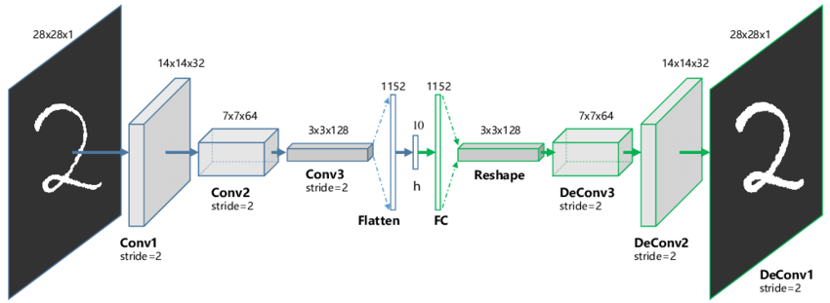
Why is this network structure not a good idea for segmentation?
Not good because when we flatten after conv3, the spacial relationship between them is lost which is a lot of information. 2, if we use a different size of an image the whole things break? Solution remove linea
Layer and flattening, use just convolution.
It doesn’t work for all size images!
https://www.researchgate.net/figure/The-structure-of-proposed-Convolutional-AutoEncoders-CAE-for-MNIST-In-the-middle-there_fig1_320658590

Slide 34
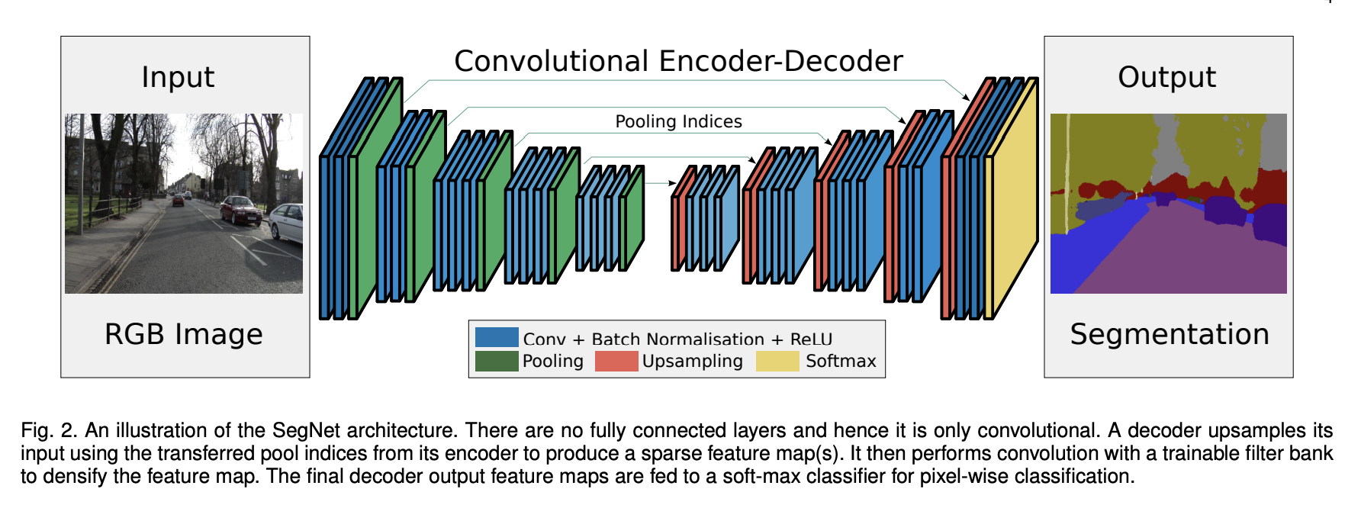
Fully Convolutional Networks
Why do we need to shrink spacially even though growing in dimensions and vice versa using the encoder-decoder below? Starts from small fine details, and go to big picture the …
Encoder gets the rich big picture then the big picture gets or brings back the whole…..?
An issue is going through all the layers, we loose fine details like tree branches etc..soln – skip connection.
Badrinarayanan et. al., 2016

Slide 35
Skip Connections
A Skip Connection is when you append the results from a previous layer (usually from the encoder) to a later layer (usually in the decoder) before feeding the information through the network.
A Residual Connection is a special kind of skip connection where you add the input of a layer to the output of that layer.
Both of these help stabilize training and preserve finer details in the output segmentations.

Slide 36
U-Net
Everything we do convolution go left then pull, go down. Going up is conv, and upsample. Its different because for each stage when upsampling, the steps data/information on the left is appended to the layer on the right so it can easily recognise more fine details.

Slide 37
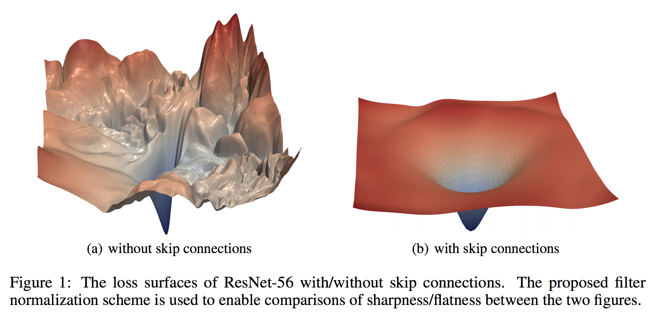
Without skip connnections, loss funcs have too many humps and so difficult to optimise or find the local minima. But with skip connections with appended data, there is less noise and its smoother,
Easier to get the local minima. Resnet → residual connection. One of the most cited papers.
http://papers.nips.cc/paper/7875-visualizing-the-loss-landscape-of-neural-nets.pdf

Slide 38
Let’s See It in PyTorch!

Slide 39
What segmentation methods can you use right now?
Model Zoo on PyTorch
Dectron2 Github
Segment Anything

Slide 40
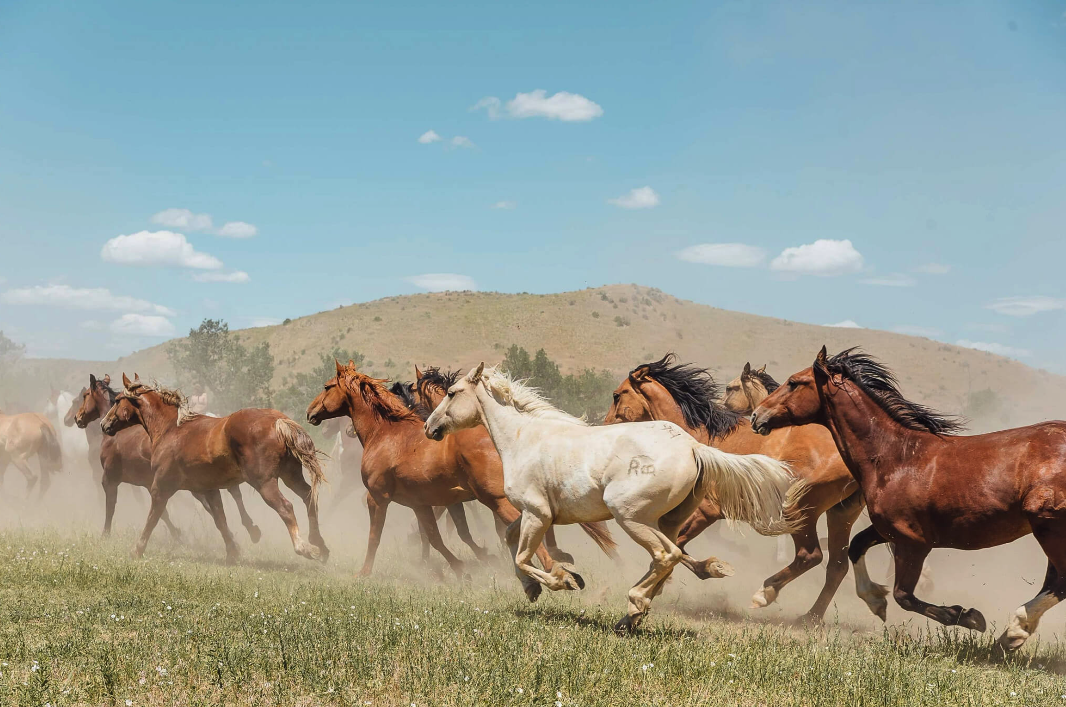
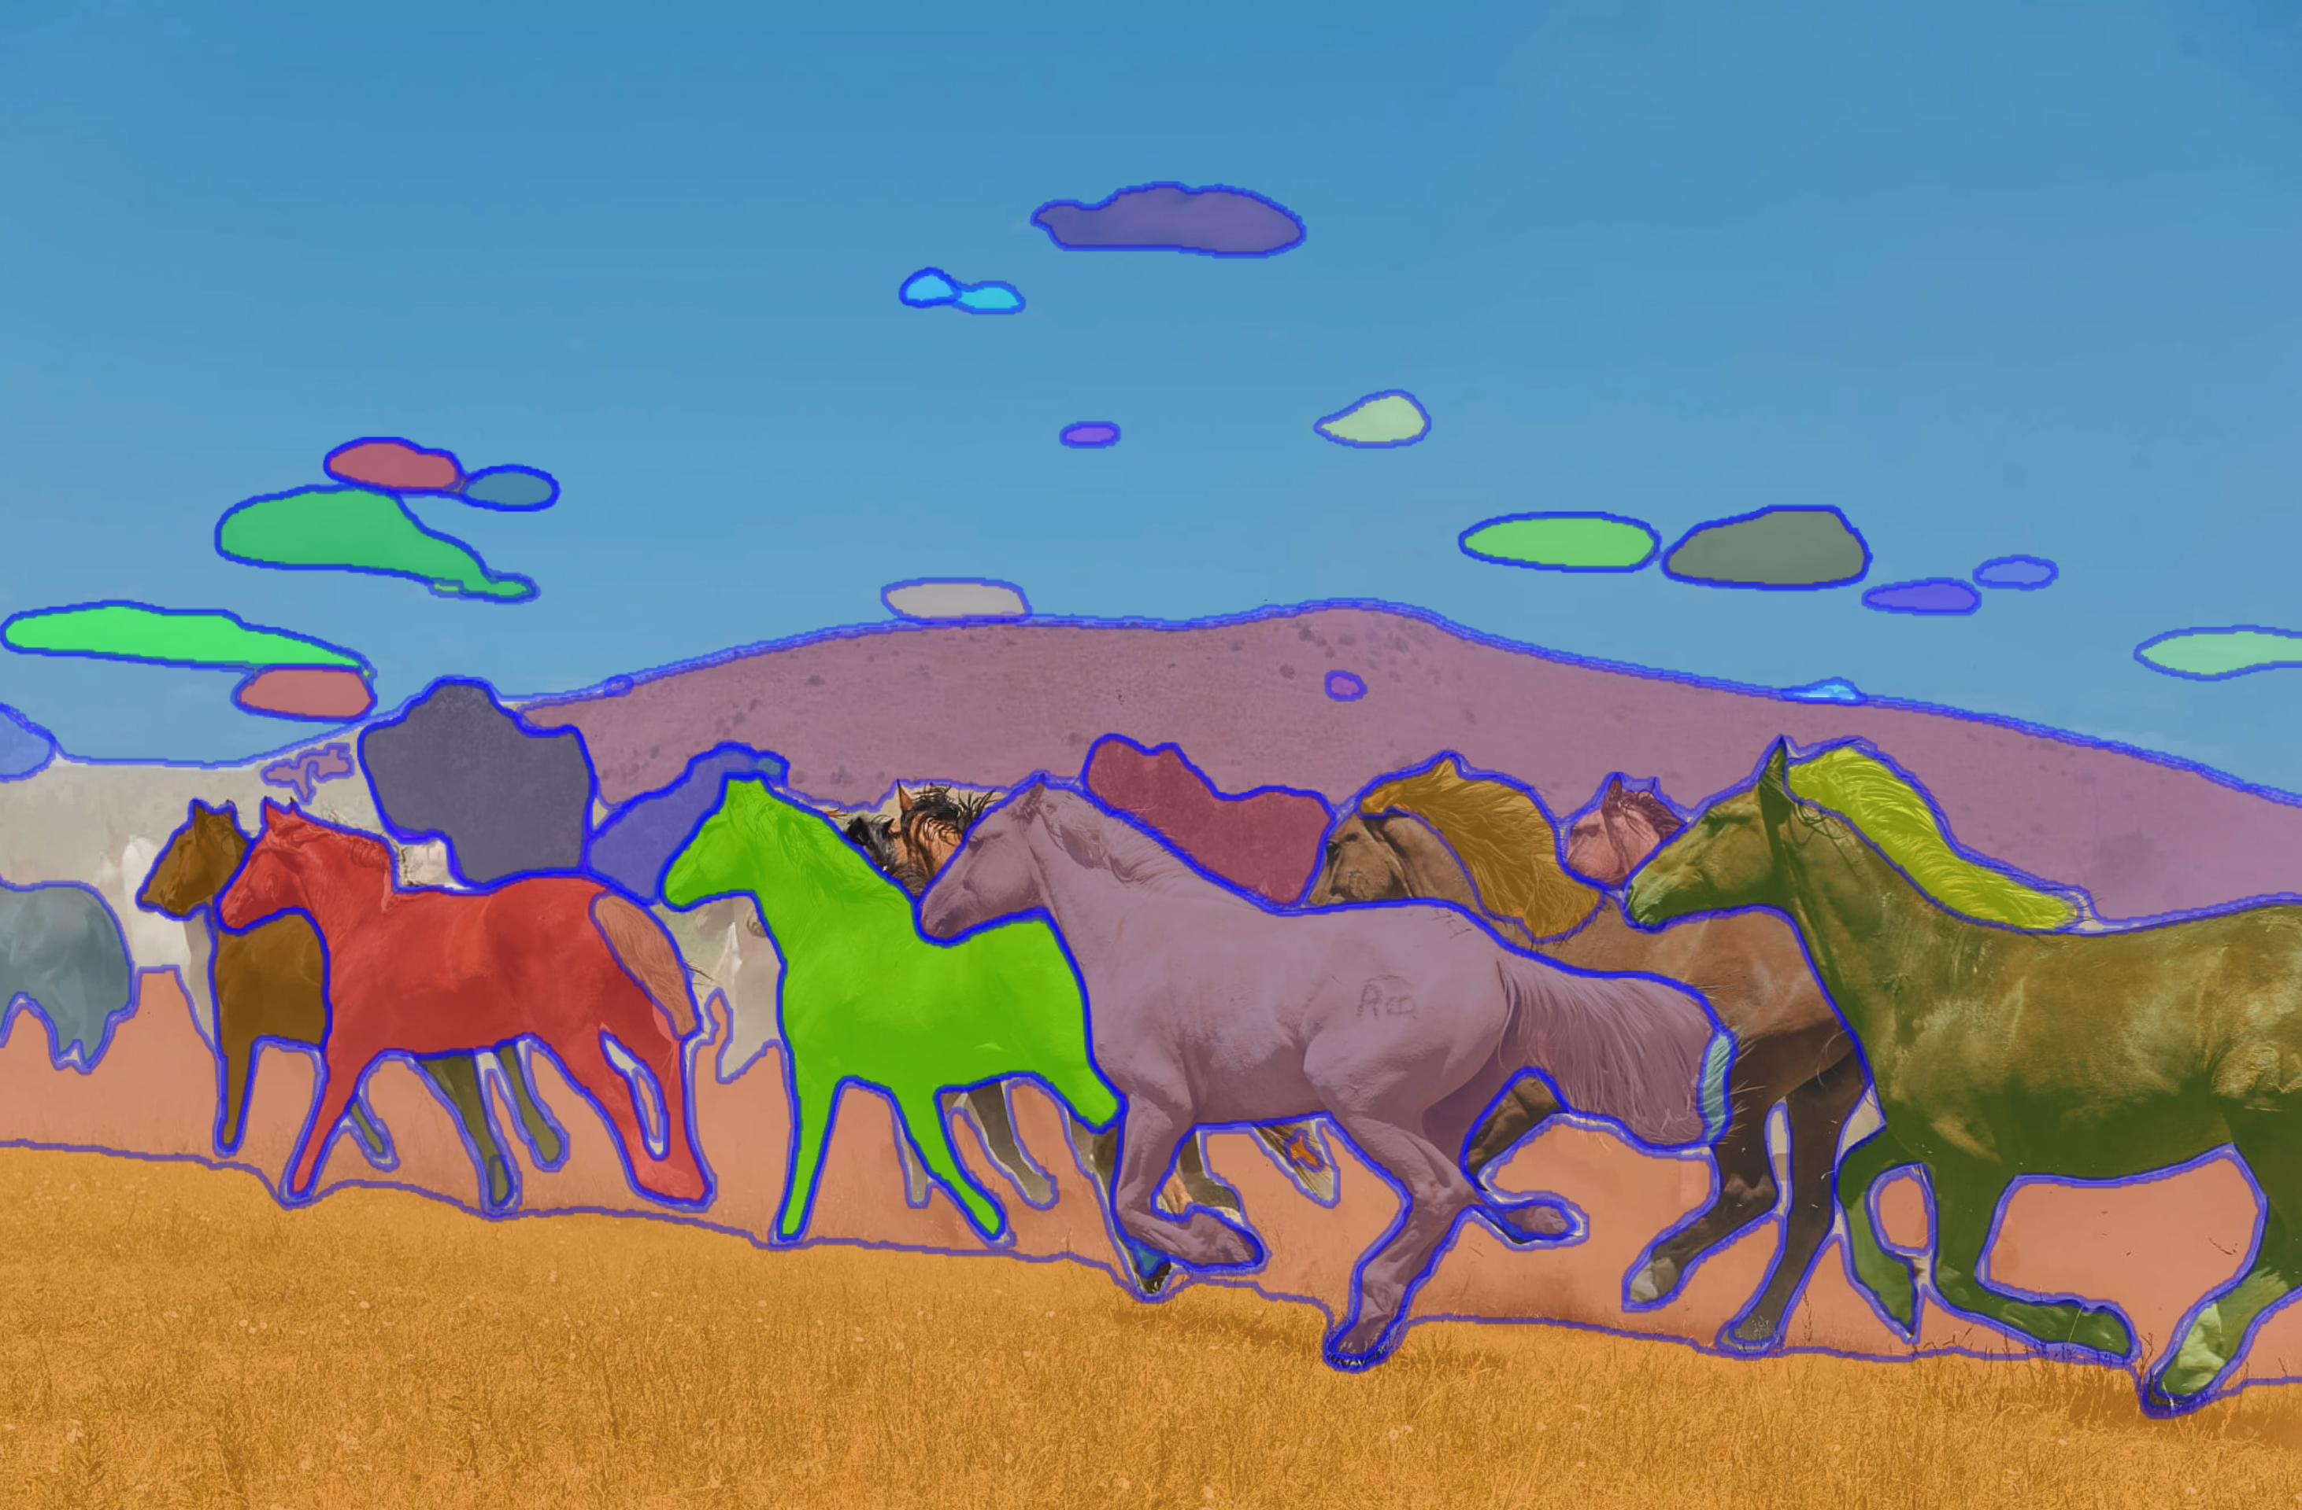
Segment Anything
Segment anything3, is an open source that can even segment things in 3D.
State-of-the-art approach that does not rely on having class labels.
Can segment all parts of the image or segment based on user input.

